Slide 1
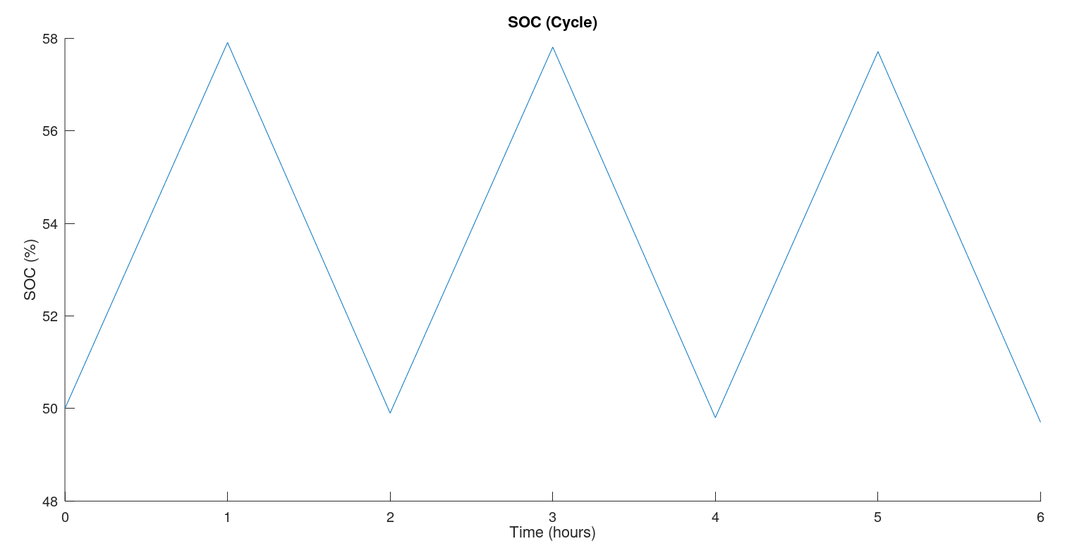
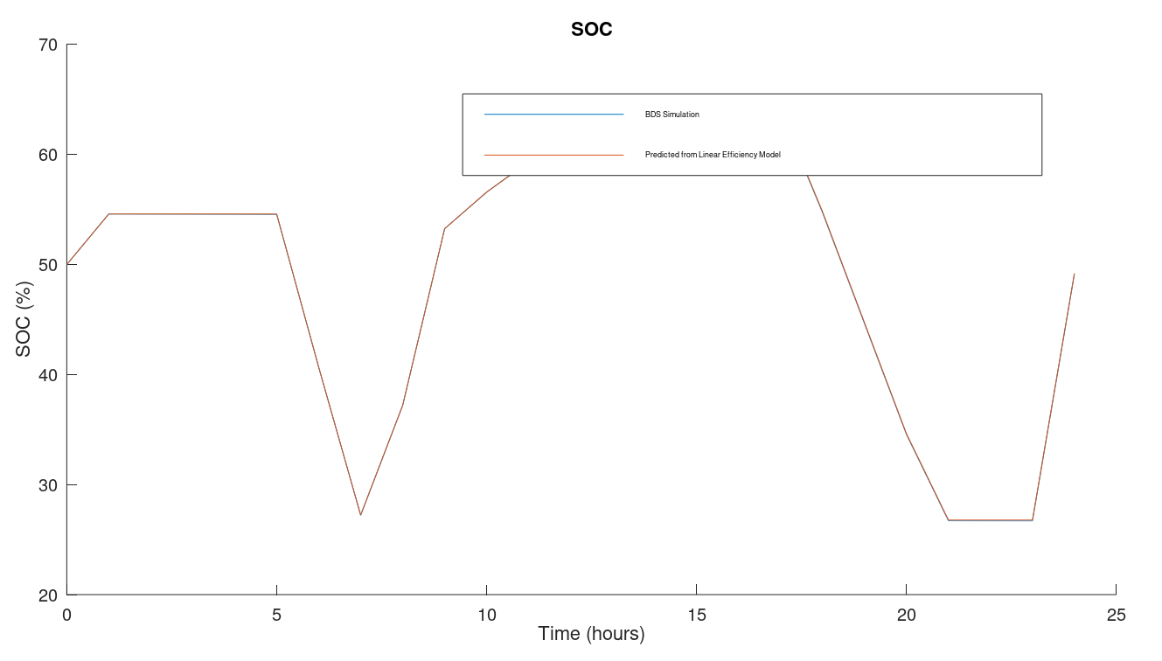
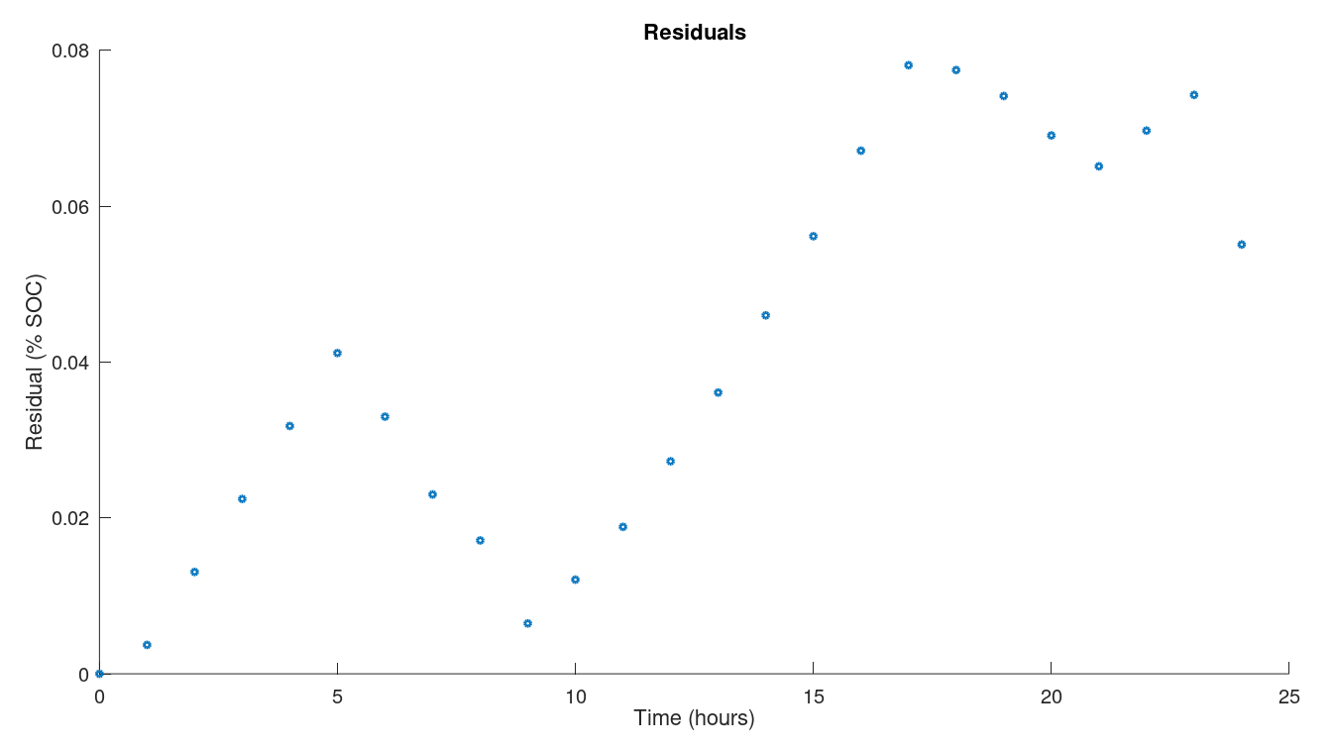
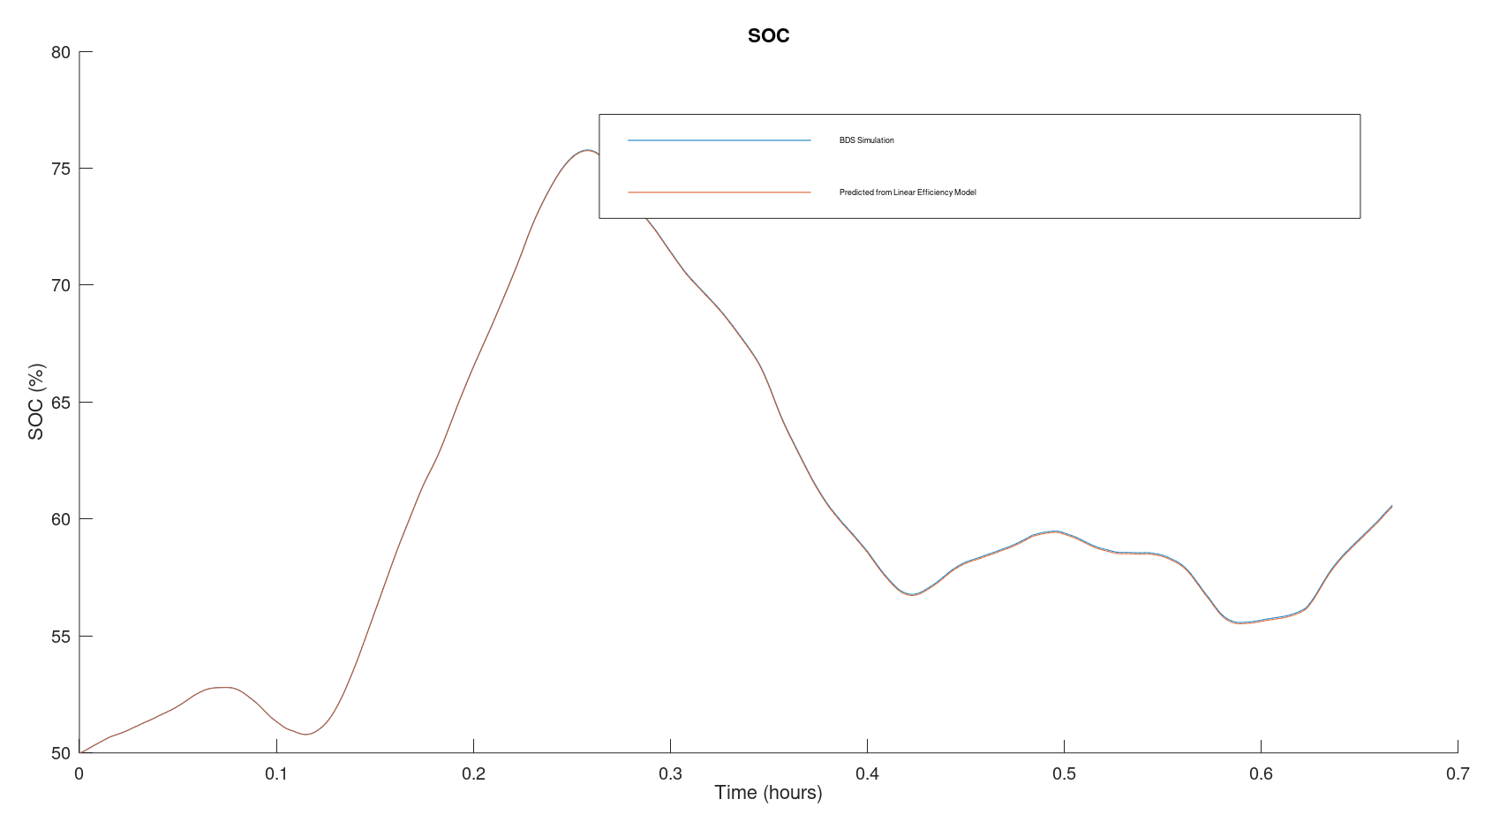
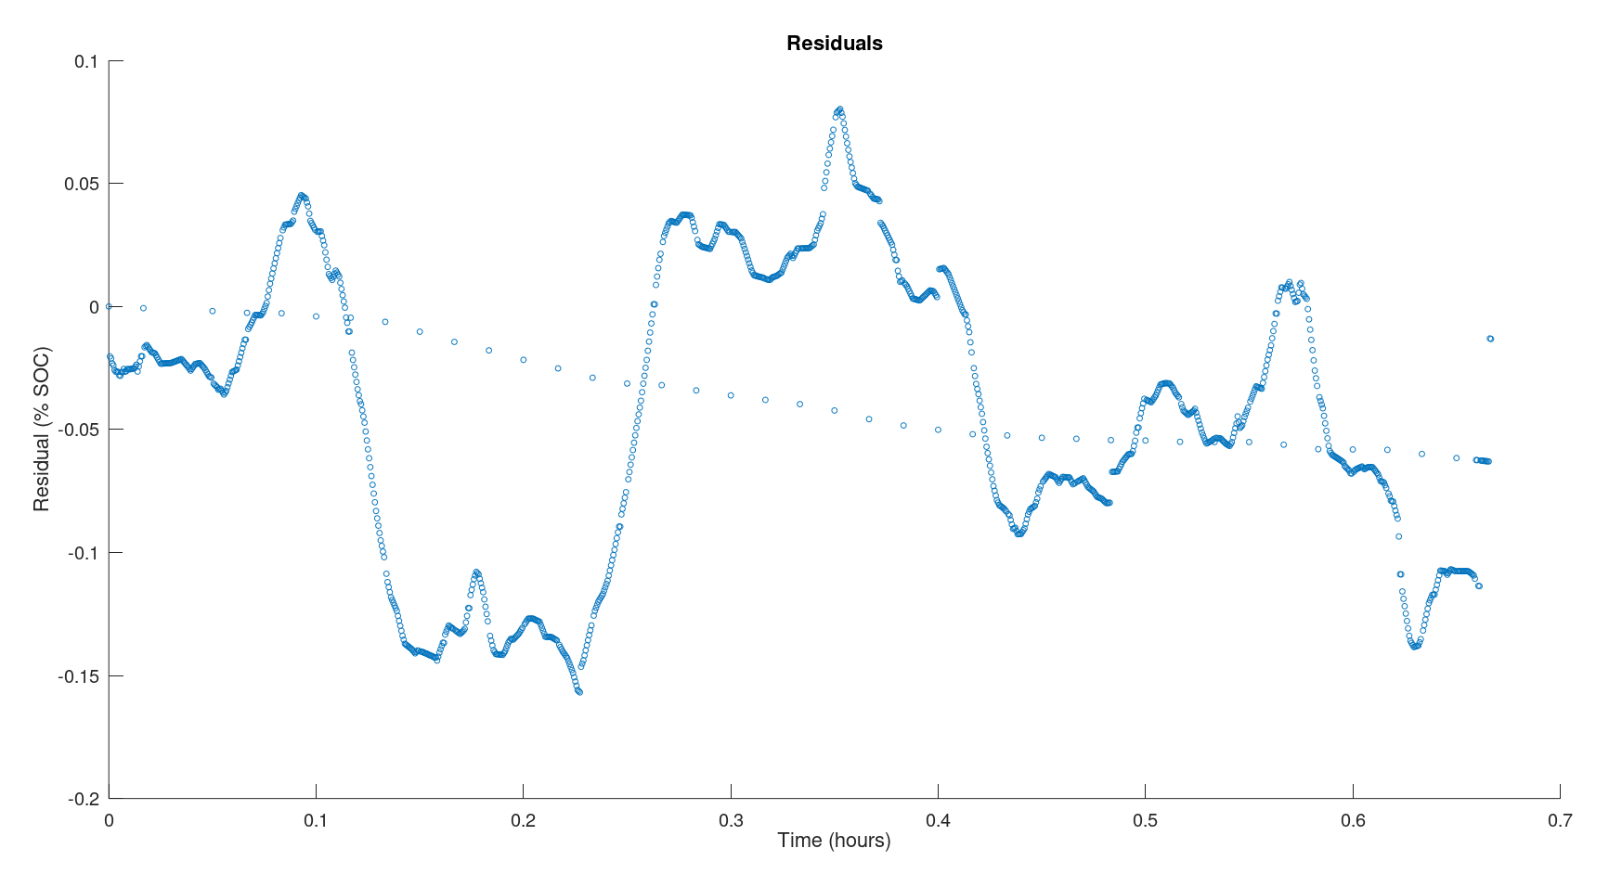
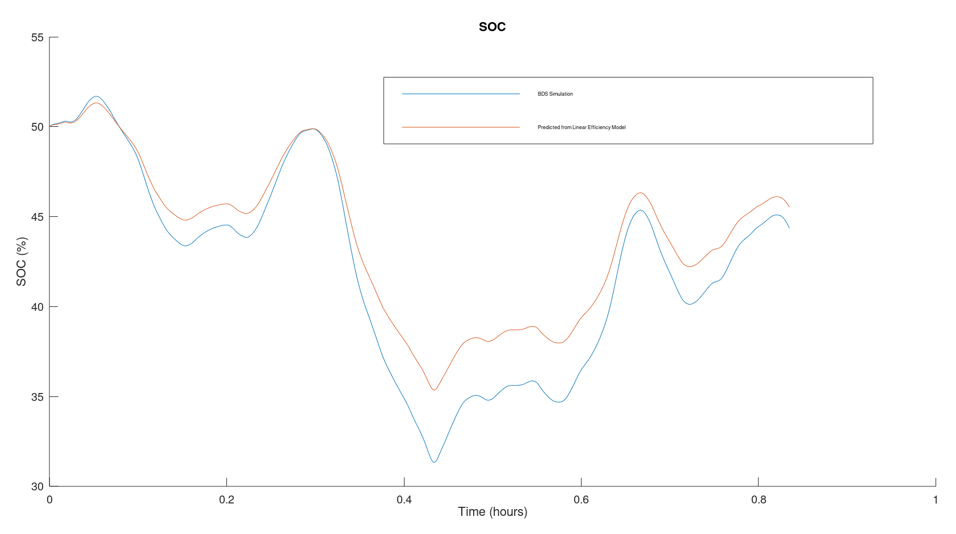
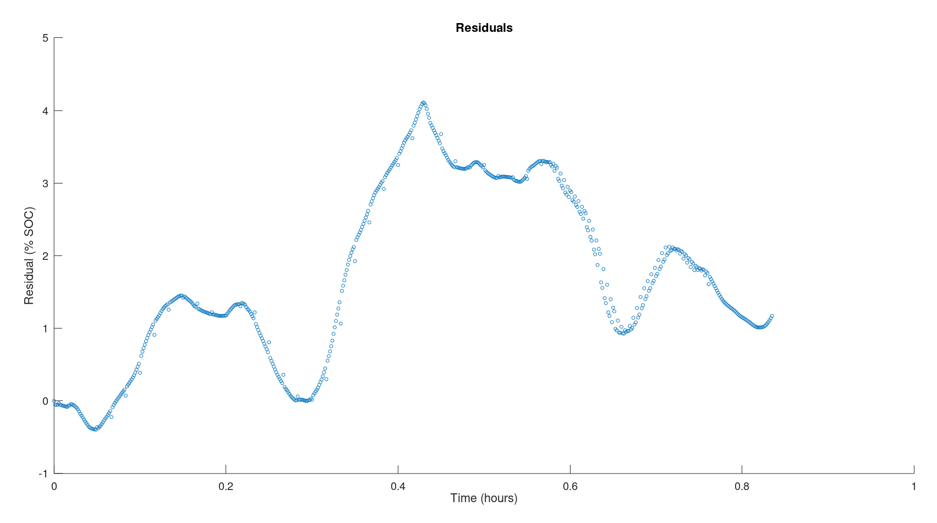

Characterizing Error in Linear Battery State of Charge Model CEE 292X Fall 2019 Corey Shono & Timnah Zimet
Motivation
Results
Methodology
Background
Battery state of charge (SOC) cannot be measured directly in practice, and yet it is important in all battery applications. While complex models of batteries and equivalent circuit models (ECMs) offer more accurate results, mathematical approximations are used often. The simplest approximation is efficiency as a constant coefficient of charge.
Key Questions
How accurate is the approximation of a constant efficiency as the coefficient of charge or discharge current?
Are other simple mathematical models of efficiency able to better approximate the battery SOC?
Calculating efficiency terms
Linear SOC estimation with constant efficiency coefficient
As a “ground truth” we use the simulation results of the BDS default NiMH cell ECM. We then compare the simulation SOC to the results using the following simple model:
$$Q_{t}=Q_{t−1}+ γ_{c}c_{t}∆t−γ_{d}d_{t}∆t$$
where Q is the state of charge, c is the charge rate, d is the discharge rate, ϒ_{c} and ϒ_{d} are the charge and discharge efficiencies, and Δt is the time step.
To calculate ϒ_{c} and ϒ_{d}, we use a pulse cycle in BDS, so that c and d are each constant for long time periods.
To evaluate the accuracy, we then use these ϒ_{c} and ϒ_{d} to predict the SOC with realistic charge cycles, and compare to the BDS results with the same cycles.
The accuracy is measured as residuals, or error in % SOC, at each time step. Error accumulates at each time step, so the final residual value is a good indicator of accuracy for the time period.
SOC estimation with variable efficiency
In order to capture the effects of SOC and charge rate on the battery’s internal resistance, a multivariate linear model was fitted to predict the efficiency of each timestep for a given SOC and current according to the following equation:
$$γ_{c,t}= θ_{c,Q}Q_{t}+θ_{c}c_{t}+ θ_{c,0}$$
$$γ_{d,t}= θ_{d,Q}Q_{t}+θ_{d}d_{t}+ θ_{d,0}$$
SOC is then predicted in the same forward-stepping fashion as before from t=0 but with efficiency updated at each time step. The residuals over time were compared between the two models
Additional battery modeling in literature
Existing literature mostly focuses on a constant efficiency term that affects the resistive component of an ECM, or assumes the constant efficiency we analyze here in order to do other experiments. One exception is a mathematical model with piecewise efficiency terms [1].
Input cycle:
1A charge and discharge rates at 1 hour each
Results:
Charge efficiency: 0.9889
Discharge efficiency: 0.9988
(or 1.001178 in SOC equation)
Evaluating accuracy: compare BDS to linear efficiency SOC prediction
Conclusions & Future Work
Key takeaways
In more smooth/regular cycles, the absolute error in SOC due to efficiency approximation is less than 1%.
In cycles with higher variation, the absolute error in SOC increases.
The actual error in real measurements is a result of noise and inaccurate current measurements, in addition to SOC estimation.
Training efficiency models on cycles with a significant amount of variability in SOC and charge rate, provides better SOC estimation on unseen test signals.
SOC predictions using a variable efficiency term as a function of SOC and current provides less drift in residuals over time than the predicting based on the average efficiency
Future steps
Evaluate additional models for efficiency as a function of temperature, SOC, etc.
Observe effects on entire battery pack as opposed to single cell.
Observe accuracy for transportation battery cycles.
Input cycle: daily peak shifting
Results: Max residual 0.078% SOC, final residual 0.055% SOC
Input cycle: regulation D signal
Results: Max residual -0.16% SOC, final residual -0.065% SOC
Bibliography
[1] N. DiOrio, A. Dobos, S. Janzou, A. Nelson, and B. Lundstrom, “Technoeconomic Modeling of Battery Energy Storage in SAM”, National Renewable Energy Laboratory, Tech. Report. TP-6A20-64641, Sep. 2015.
[2] W. Powell and H. Cheng. Workshop, “Co-optimization of battery storage over multiple revenue streams and time scales.” PENSA Laboratory, Princeton University, Princeton, NJ, Jun. 21, 2015.
[3] E. Raszmann, K. Baker, Y. Shi, and D. Christensen, “Modeling Stationary Lithium-Ion Batteries for Optimization and Predictive Control” National Renewable Energy Laboratory, Tech. Report. CP-5D00-67809, Feb. 2017.
Input cycle: less smooth regulation D signal
Results: Max residual 4.1% SOC, final residual 1.2% SOC
Acknowledgements
Thank you to our mentor, Thomas Navidi.

